Slide 1
OpenCV Tutorial
Part I
Using OpenCV with Microsoft Visual Studio .net 2003
28 November 2005
Gavin S Page gsp8334@cs.rit.edu

Slide 2
OpenCV
What is OpenCV?
(from the documentation)
OpenCV means Intel® Open Source Computer Vision Library. It is a collection of C functions and a few C++ classes that implement some popular Image Processing and Computer Vision algorithms.
The key features
(from the documentation)
Cross-Platform API of C functions
FREE for commercial and non-commercial uses
What this means
You can take advantage of high speed implementations of functions commonly used in Computer Vision/Image Processing.
28 November 2005
Gavin S Page gsp8334@cs.rit.edu

Slide 3
OpenCV
How to obtain the library
Available on Sourceforge
http://sourceforge.net/projects/opencvlibrary/
(Or use your favorite search engine)
How to install the library
(On Windows)
Download and Install the Executable
28 November 2005
Gavin S Page gsp8334@cs.rit.edu

Slide 4
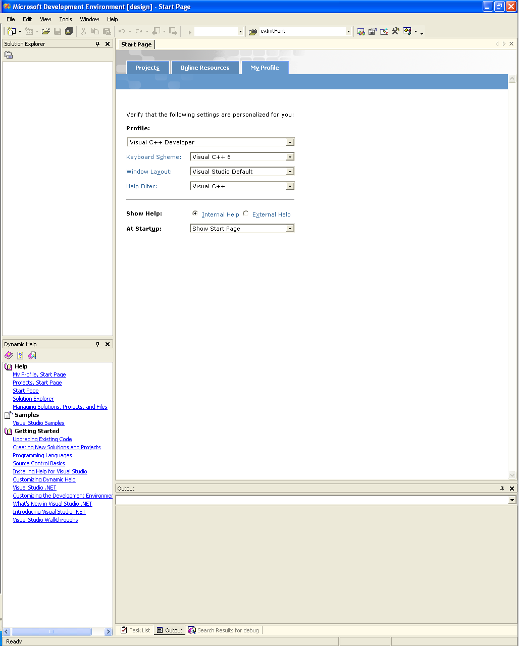
Configuring MSVS .net 2k3
Upon loading Visual Studio it is recommended that you adjust the profile to that of “Visual C++ Developer.” This will help keep things straight when I reference keyboard shortcuts later on.
28 November 2005
Gavin S Page gsp8334@cs.rit.edu

Slide 5
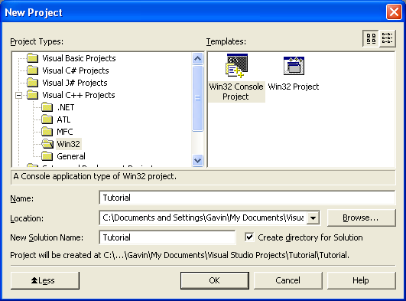
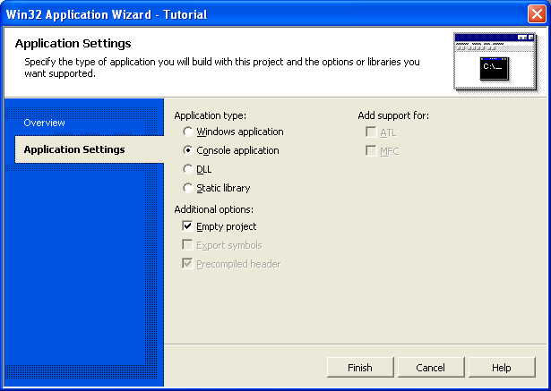
Configuring MSVS .net 2k3
Creating the Project
A project is initially created by selecting:
File -> New -> Project
Create a “Win32 Console Project”
Make it an “Empty Project” by selecting the box under “Application Settings”
28 November 2005
Gavin S Page gsp8334@cs.rit.edu

Slide 6
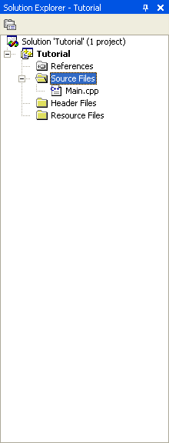
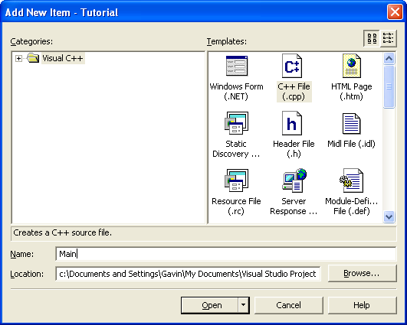
Configuring MSVS .net 2k3
Create the First File
Right Click the “Source Files” Folder under the project name (“Tutorial” in this case)
Add -> Add new Item
Select “C++ file” and give it a name
Creating a file makes it possible to set “Additional Include Directives” in the C/C++ pane under the project properties.
28 November 2005
Gavin S Page gsp8334@cs.rit.edu

Slide 7
Configuring MSVS .net 2k3
In order to build projects using OpenCV the required libraries and directives must be included in the project’s properties
Open the Properties Pane
Right Click the name of the project and select “Properties”
(“Tutorial” in this case)
28 November 2005
Gavin S Page gsp8334@cs.rit.edu

Slide 8
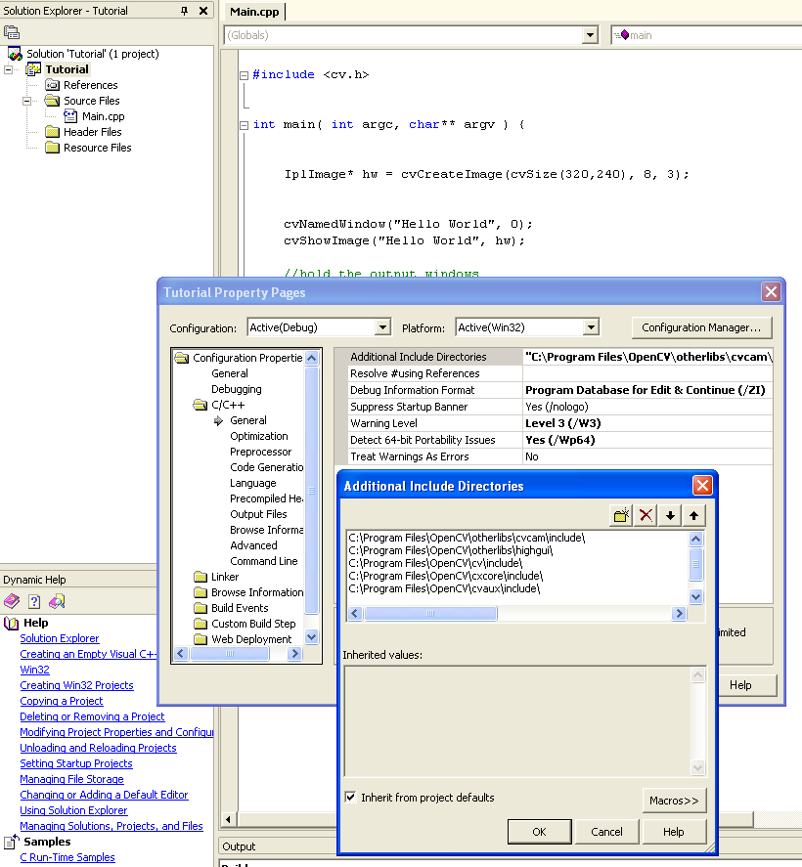
Configuring MSVS .net 2k3
Set Additional Include Directives
Under the C/C++ tab select “General”
Select the “Additional Include Directives”
Add the full path to each of the folders which contain “.h” files required to use OpenCV
Be sure to include trailing “\”
Utilized Directives
C:\Program Files\OpenCV\cvaux\include\
C:\Program Files\OpenCV\cxcore\include\
C:\Program Files\OpenCV\cv\include\
C:\Program Files\OpenCV\otherlibs\highgui\
C:\Program Files\OpenCV\otherlibs\cvcam\include\
28 November 2005
Gavin S Page gsp8334@cs.rit.edu

Slide 9
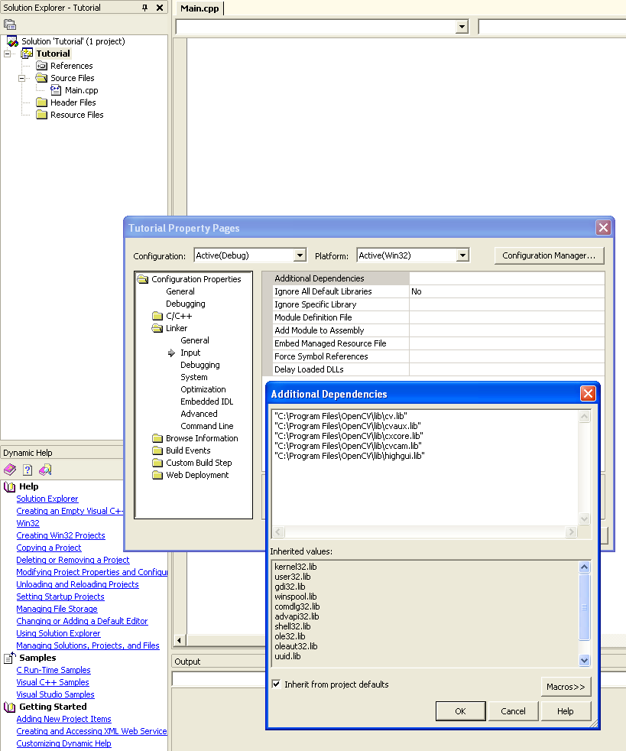
Configuring MSVS .net 2k3
Set Additional Dependencies
Under the Linker tab select “Input”
Select the “Additional Dependencies”
Add the full path to each of the “.lib” files required to use OpenCV
Be sure to keep the paths in quotes
Utilized Dependencies
"C:\Program Files\OpenCV\lib\cv.lib“
"C:\Program Files\OpenCV\lib\cvaux.lib“
"C:\Program Files\OpenCV\lib\cxcore.lib“
"C:\Program Files\OpenCV\lib\cvcam.lib“
"C:\Program Files\OpenCV\lib\highgui.lib"
28 November 2005
Gavin S Page gsp8334@cs.rit.edu

Slide 10
Testing MSVS .net 2k3
#include <cv.h>
#include <highgui.h>
/*
This will pop up a small box with "Hello World" as the text.
@author: Gavin Page, gsp8334@cs.rit.edu
@date: 28 November 2005
*/
int main( int argc, char** argv ) {
//declare for the height and width of the image
int height = 320;
int width = 240;
//specify the point to place the text
CvPoint pt = cvPoint( height/4, width/2 );
//Create an 8 bit, 3 plane image
IplImage* hw = cvCreateImage(cvSize(height, width), 8, 3);
//initialize the font
CvFont font;
cvInitFont( &font, CV_FONT_HERSHEY_COMPLEX,
1.0, 1.0, 0, 1, CV_AA);
//place the text on the image using the font
cvPutText(hw, "Hello World", pt, &font, CV_RGB(150, 0, 0) );
//create the window container
cvNamedWindow("Hello World", 0);
//display the image in the container
cvShowImage("Hello World", hw);
//hold the output windows
cvWaitKey(0);
return 0;
}
Now that the environment is configured it would be a good idea to test it to make sure that a program will correctly build and run.
Testing the First Program
The enclosed code can be cut and pasted into the file created in the project space to test OpenCV
28 November 2005
Gavin S Page gsp8334@cs.rit.edu

Slide 11
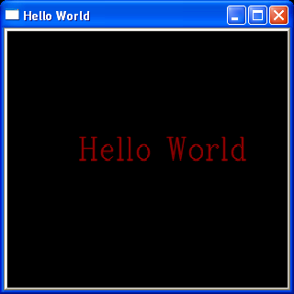
Testing MSVS .net 2k3
Building the Program
The program is built by selecting:
Build -> Build Solution
Or by pressing “F7”
Output of Program
Running the Program
The program is run by selecting:
Debug -> {Start||Start without Debugging}
Or by pressing “F5” or
“<Ctrl>-F5”
28 November 2005
Gavin S Page gsp8334@cs.rit.edu

Slide 12
At this point you should have a working OpenCV project. If the program is not working you should go back and carefully recheck the steps.
From here you can explore the documentation to review the functions available.
There are also a number of tutorials on the web including:
http://www.site.uottawa.ca/~laganier/tutorial/opencv+directshow/cvision.htm
http://www.softintegration.com/products/thirdparty/opencv/demos/
Or you can just search for them
You should also join the OpenCV Community located at:
http://groups.yahoo.com/group/OpenCV/
As of today there are >15000 members available to answer questions. There is also a searchable message board where you can look up previous queries.
28 November 2005
Gavin S Page gsp8334@cs.rit.edu

Slide 13
Revision History
Initial Creation: 28 November 2005
28 November 2005
Gavin S Page gsp8334@cs.rit.edu

